Slide 1




SMART ENERGY METER WITH THEFT DETECTION
Presented by: Nandakishore .P
Abhinandh. K
Arjun .P.S
Veda Krishnan .V .A

Slide 2

INTRODUCTION
  Electricity is essential for daily life
  Traditional meters lack real-time monitoring
  Electricity theft causes major revenue loss
  Smart meters improve energy management

Slide 3

PROBLEM STATEMENT
  Electricity theft causes revenue loss
  Traditional meters lack tamper detection
  No real-time usage monitoring
  Manual billing leads to errors

Slide 4

EXISTING SYSTEM ISSUES
  Manual meter reading process
  No real-time monitoring system
  Easy meter tampering and bypass
  Delayed theft detection
  Inaccurate billing and data errors
  No remote data transmission capability

Slide 5
PROPOSED SOLUTION
  Smart digital energy measurement
  Real-time theft detection system
  Automatic alert notification
  Cloud-based data monitoring
  Secure and accurate billing

Slide 6
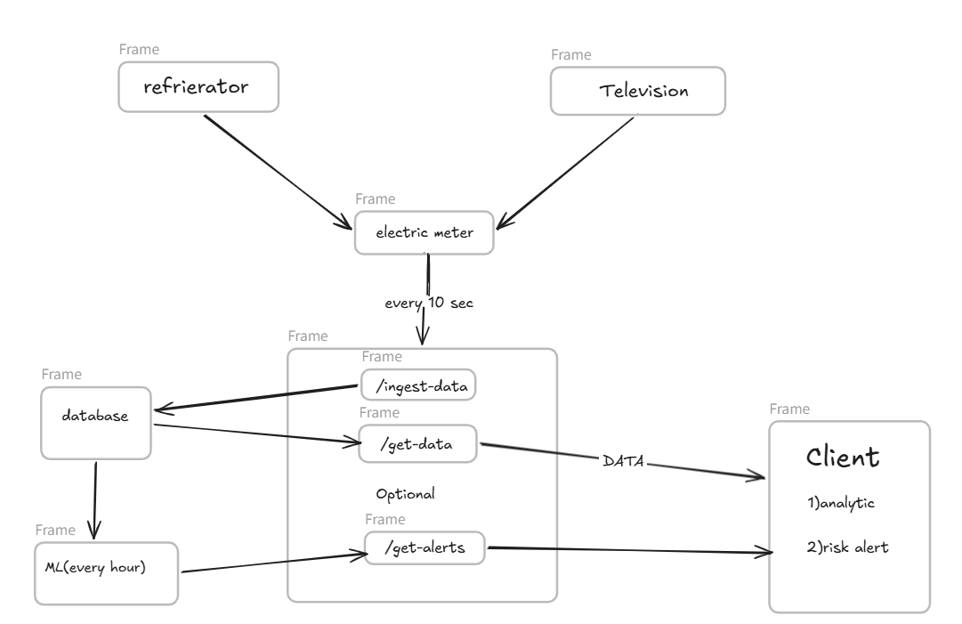
SYSTEM ARCHETECTURE
Tech stack
  Next.js
  Python
  XGBoost
  MongoDB
  Flutter
  ESP8266
  ACS710

Slide 7
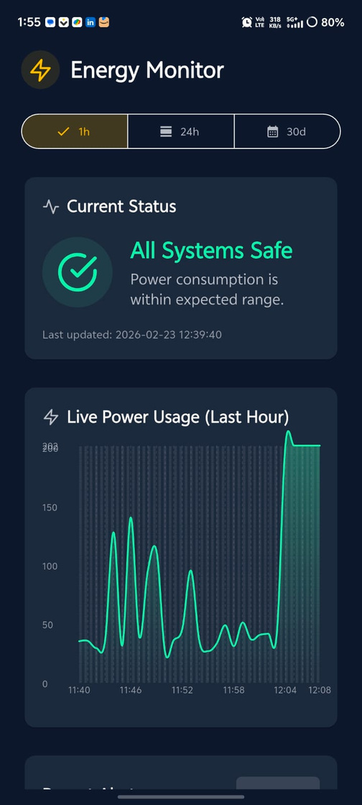
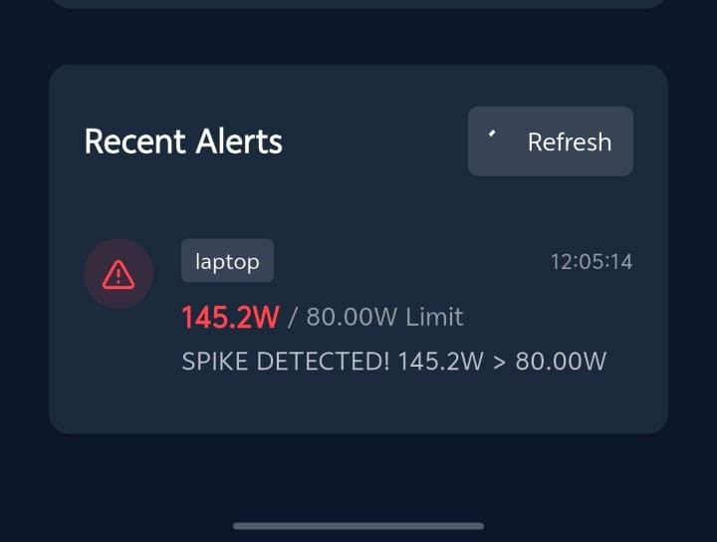
DEMO

Slide 8
Business Model
  Sell smart meters to electricity companies
  Charge monthly fee for monitoring software
  Charge yearly maintenance fees
  Provide advanced data reports for extra cost
  Partner with government smart city projects

Slide 9
FUTURE SCOPE
  INTEGRATION WITH SMART GRID SYSTEMS
  AI-based advanced theft prediction
  Large-scale deployment in smart cities
  Subscription-based SaaS platform for utilities
  Expansion to national and international markets

Slide 10
CONCLUSION
  Real-time energy monitoring system
  Instant theft detection & alerts
  Secure cloud-based data management
  Accurate and automated billing
  Scalable for smart city integration

Slide 11
THANK YOU

